Slide 1
Christ Church Lille
Outreach and Mission
La Solidarité Anglicane de Lille
LA SOLIDARITE ANGLICANE DE LILLE
Annual General Meeting
11 March 2024
'Truly I tell you, whatever you did for one of the least of these brothers and sisters of mine, you did for me.’
Matthew 25:40
Notes:
This quotation from St Matthew’s Gospel sums up what we are trying to do here at Christ Church – express our belief and trust in Christ by helping other people.

Slide 2
Christ Church Lille
Outreach and Mission
La Solidarité Anglicane de Lille
I Welcome
  Opening with prayers
  Apologies for absence
  Electoral roll
II The committee
III Minutes of the 2023 AGM
  Approval of minutes
  Matters arising
IV Report on Grants made during 2023
V Accounts for 2023
VI Closing remarks

Slide 3
Christ Church Lille
Outreach and Mission
La Solidarité Anglicane de Lille
Electoral roll
All members on the Christ Church Lille electoral roll are automatically members of the Solidarité Anglicane de Lille.
There are currently 29 names on the roll.

Slide 4
Christ Church Lille
Outreach and Mission
La Solidarité Anglicane de Lille
I Welcome
  Opening with prayers
  Apologies for absence
  Electoral roll
II The committee
III Minutes of the 2023 AGM
  Approval of minutes
  Matters arising
IV Report on Grants made during 2023
V Accounts for 2023
VI Closing remarks

Slide 5
Christ Church Lille
Outreach and Mission
La Solidarité Anglicane de Lille
Committee Members
President | Frances Coester
Secretary | Rosemary Ulyett
Treasurer | Constantin Thieffry
 | Reverend Canon Debbie Flach
 | Suzanne Bray
 | David Bolton
 | Maggie Devos
 | Peter Hawkins
CCL Treasurer | Ann Beckwith

Slide 6
Christ Church Lille
Outreach and Mission
La Solidarité Anglicane de Lille
I Welcome
  Opening with prayers
  Apologies for absence
  Electoral roll
II The committee
III Minutes of the 2023 AGM
  Approval of minutes
  Matters arising
IV Report on Grants made during 2023
V Accounts for 2023
VI Closing remarks

Slide 7
III Minutes of the Annual General Meeting held on 21 March 2023
Christ Church Lille
Outreach and Mission
La Solidarité Anglicane de Lille
Approval of minutes
Matters arising

Slide 8
Christ Church Lille
Outreach and Mission
La Solidarité Anglicane de Lille
I Welcome
  Opening with prayers
  Apologies for absence
  Electoral roll
II The committee
III Minutes of the 2023 AGM
  Approval of minutes
  Matters arising
IV Report on Grants made during 2023
V Accounts for 2023
VI Closing remarks

Slide 9
IV Report on Grants made during 2023
(based on 2022 revenues)
Christ Church Lille
Outreach and Mission
La Solidarité Anglicane de Lille

Slide 10
Christ Church Lille
Outreach and Mission
La Solidarité Anglicane de Lille
In 2023 we supported local, national and international organisations
Notes:
We try to spread our help as widely as possible, giving to both small and large organisations

Slide 11
Christ Church Lille
Outreach and Mission
La Solidarité Anglicane de Lille
SUPPORTING WORK IN OUR COMMUNITY
Notes:
We give to those who are working locally to help the homeless and the lonely in the Lille area

Slide 12

Notes:
The ABEJ welcomes, houses, and gives medical care to people living on the streets in Lille, providing a safe environment and help towards achieving a better future,

Slide 13
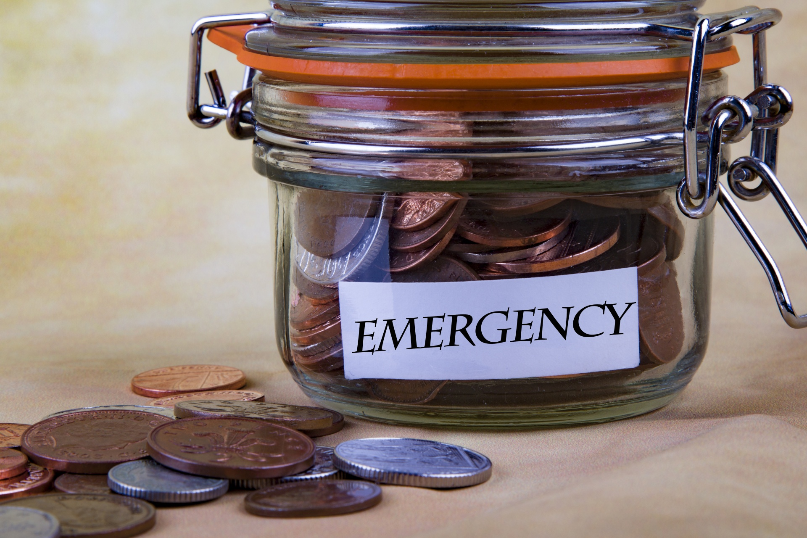
Christ Church Lille
Outreach and Mission
La Solidarité Anglicane de Lille
SUPPORTING WORK IN OUR COMMUNITY
Notes:
The Chaplain’s discretionary fund enables Debbie to help those with an immediate need for small sums.

Slide 14
Christ Church Lille
Outreach and Mission
La Solidarité Anglicane de Lille
SUPPORTING WORK IN FRANCE
Notes:
We try to reach out to other parts of France

Slide 15

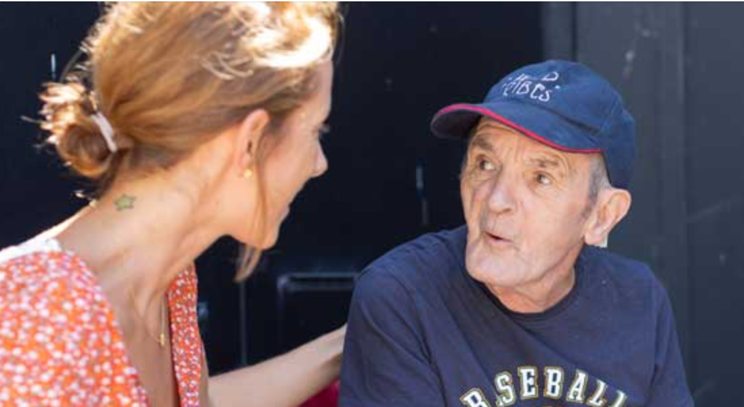
LES PETITS FRERES DES PAUVRES
Notes:
The Petits Frères des Pauvres help the elderly all over France, those in poverty who need practical assistance but also those who are isolated and lonely by visiting and bringing them much needed company.

Slide 16
Christ Church Lille
Outreach and Mission
La Solidarité Anglicane de Lille
SUPPORTING WORK IN THE WORLD
Notes:
The third arm of our outreach is to organisations working abroad

Slide 17
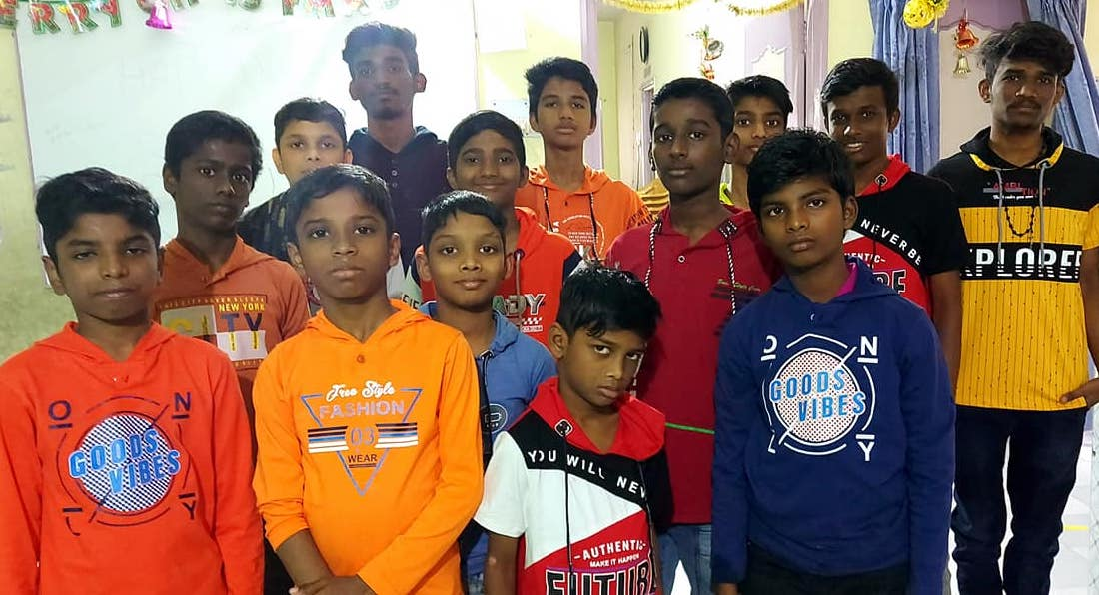
Beth Abi Orphanage
Notes:
We have been supporting the Beth Abi Orphanage at Chennai in India since 2011. Several members of the church have been to visit it and we get regular progress reports on the children we are helping. This is the most recent photo we have received.
Christian and other non-Hindu charities are currently having a hard time in India. But we enable our Indian friends to give some support.

Slide 18



Slide 19


Slide 20
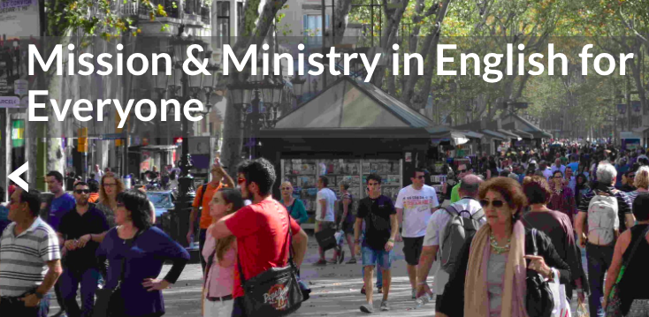
INTERCONTINENTAL CHURCH SOCIETY
Notes:
The mission of the Intercontinental Church Society, the sponsors of this church, is to set up centres for Christian worship throughout the world. They helped us to revitalise Christ Church a few years ago so we give something back each year to help them to help others.

Slide 21
Christ Church Lille
Outreach and Mission
La Solidarité Anglicane de Lille
RESPONDING TO EMERGENCIES
Notes:
The third arm of our outreach is to organisations working abroad

Slide 22


Slide 23


Slide 24
Christ Church Lille
Outreach and Mission
La Solidarité Anglicane de Lille
I Welcome
  Opening with prayers
  Apologies for absence
  Electoral roll
II The committee
III Minutes of the 2023 AGM
  Approval of minutes
  Matters arising
IV Report on Grants made during 2023
V Accounts for 2023
VI Closing remarks

Slide 25
2023 - Financials

Slide 26
Christ Church Lille and
La Solidarité Anglicane are one.
But French law means we have to separate the accounts.

Slide 27
2023 - Donations

Slide 28
Income & Expenditure

Slide 29
Approval of the accounts for 2023

Slide 30
PLANS for 2024
Grants Committee held a meeting in February 2024
Allocations based on 2023 income (combined income of CCL and Solidarité)

Slide 31
Christ Church Lille
Outreach and Mission
La Solidarité Anglicane de Lille
I Welcome
  Opening with prayers
  Apologies for absence
  Electoral roll
II The committee
III Minutes of the 2023 AGM
  Approval of minutes
  Matters arising
IV Report on Grants made during 2023
V Accounts for 2023
VI Closing remarks

Slide 32
Christ Church Lille
Outreach and Mission
La Solidarité Anglicane de Lille
VI Closing Remarks

