Slide 1
La Solidarité anglicane de Lille
Christ Church Lille
Outreach and Mission
La Solidarité Anglicane de Lille
Annual General Meeting
Monday 23 March 2026

Slide 2
Christ Church Lille
Outreach and Mission
La Solidarité Anglicane de Lille
I Welcome
  Opening with prayers
  Apologies for absence
  Electoral roll
II The committee
III Minutes of the 2025 AGM
  Approval of minutes
  Matters arising
IV Report on Grants made during 2025
V Accounts for 2025
VI Closing remarks

Slide 3
Christ Church Lille
Outreach and Mission
La Solidarité Anglicane de Lille
Electoral roll
Members of Christ Church Lille are automatically members of the Solidarité association.
There are 29 people on the electoral roll (at 2 March) who are therefore able to vote at this meeting.

Slide 4
Christ Church Lille
Outreach and Mission
La Solidarité Anglicane de Lille
The committee
Current committee members are:
  Frances Coster (President)
  Constantin Thieffry (Treasurer)
  Rosemary Ulyett (Secretary)
  Maggie Devos
  David Bolton
  Suzanne Bray
  Tony Banton (ex officio CCL Treasurer)

Slide 5
Christ Church Lille
Outreach and Mission
La Solidarité Anglicane de Lille
Minutes of the 2025 AGM
  Approval of minutes
  Matters arising

Slide 6
Christ Church Lille
Outreach and Mission
La Solidarité Anglicane de Lille
Grants made during 2025 (based on 2024 income)
  President’s report

Slide 7
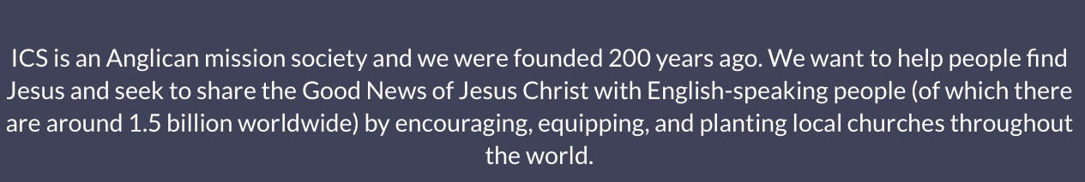

Christ Church Lille
Outreach and Mission
La Solidarité Anglicane de Lille

Slide 8
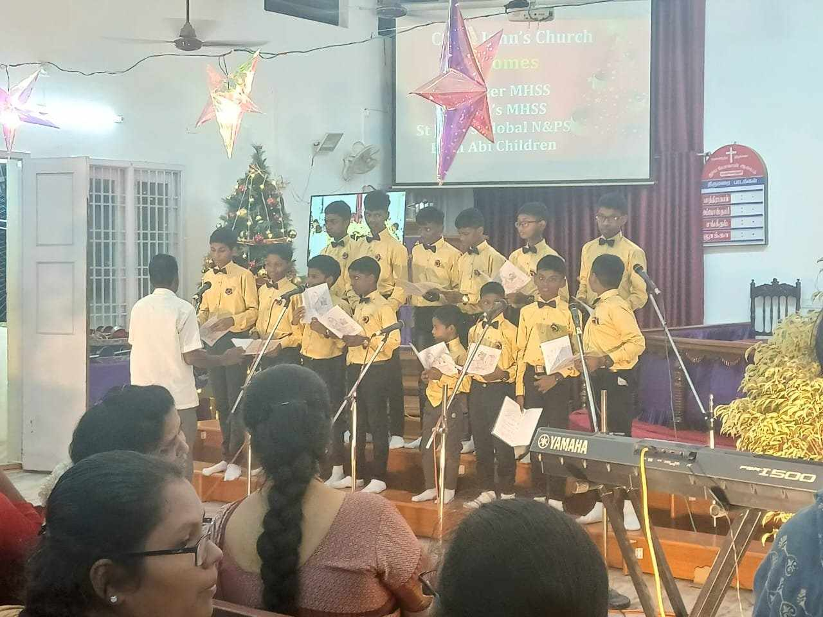
Christ Church Lille
Outreach and Mission
La Solidarité Anglicane de Lille
BETH ABI

Slide 9
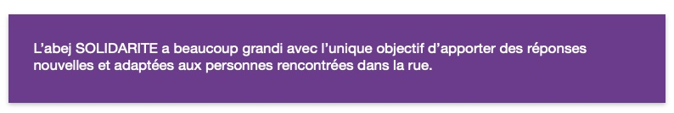
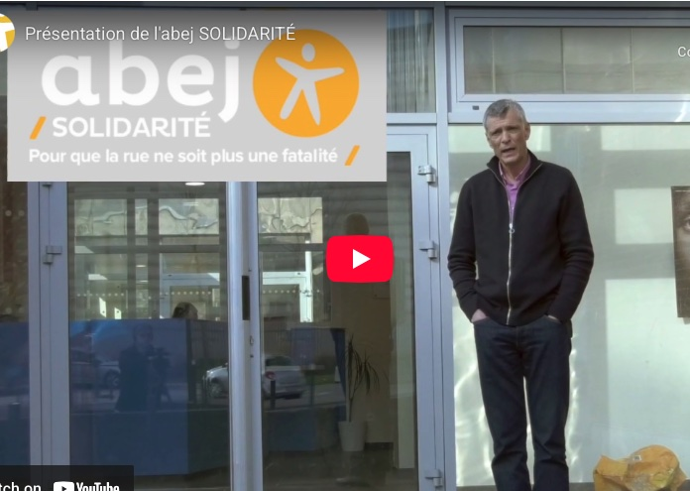
Christ Church Lille
Outreach and Mission
La Solidarité Anglicane de Lille
ABEJ
ABEJ

Slide 10
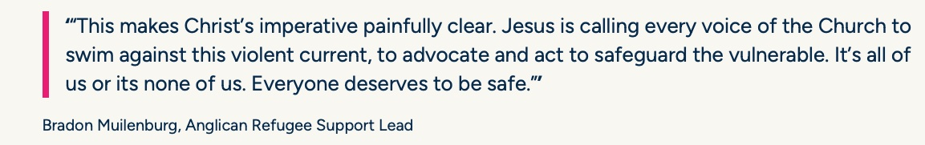
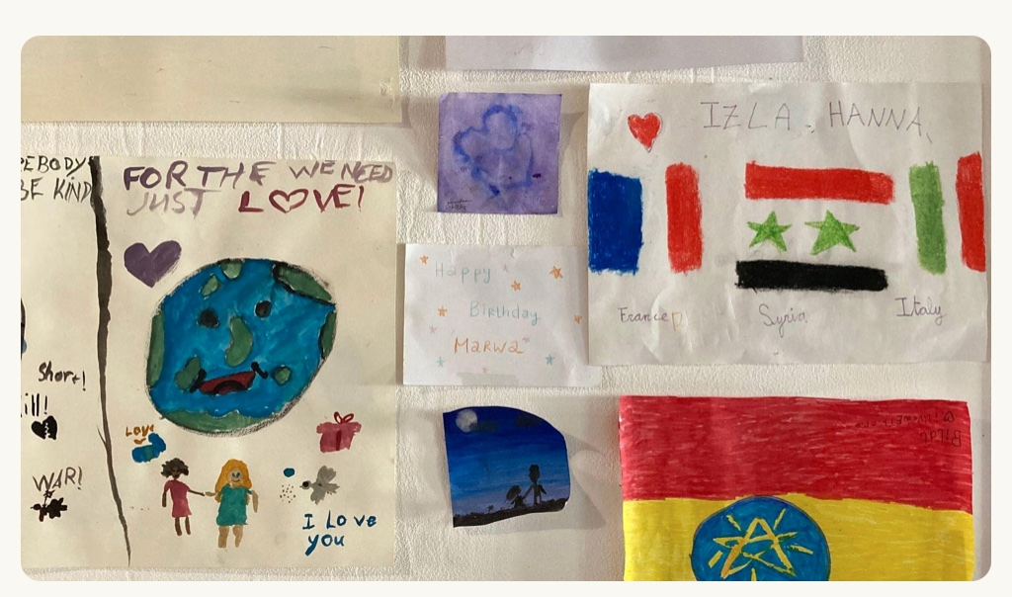
Christ Church Lille
Outreach and Mission
La Solidarité Anglicane de Lille
DIOCESAN FUND FOR REFUGEES

Slide 11
Christ Church Lille and
La Solidarité Anglicane are one.
But French law means we have to separate the accounts.

Slide 12
2025 - Donations

Slide 13
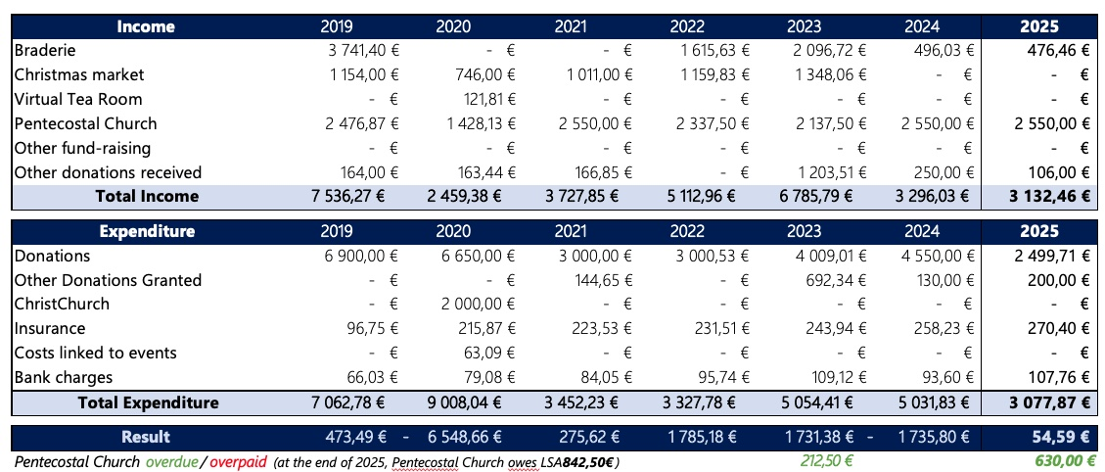
Income & Expenditure

Slide 14
“
Christ Church Lille
Outreach and Mission
La Solidarité Anglicane de Lille
Giving is important, but Outreach is more than money; it’s about sharing our time, gifts and resources.

Slide 15
Christ Church Lille
Outreach and Mission
La Solidarité Anglicane de Lille
Forms of outreach
We share our church building and reach out ecumenically
We make available space in the church hall and storage room for the Ligue Humanitaire, helping the homeless and helpless in lille
How our congregation contributes

