Slide 1
CHRIST CHURCH LILLE
AGM 2026
20 April 2026

Slide 2
CCL AGM 2026 AGENDA
Opening with prayers
Apologies for absence
The electoral roll
Minutes of the AGM held on 28 April 2025
Matters arising
Reports
Lay President’s report
Finance Report
Fabric report
Other reports
Safeguarding
Elections and appointments
Churchwardens
Synod representatives
PCC Members
Independent account examiner
Future plans
Any other business
Closing prayers

Slide 3
The Electoral Roll
There are 32 people currently on the electoral roll (as at 30 March 2026)
Only those on the roll may vote at this meeting
Only those on the electoral roll are eligible for election

Slide 4
Minutes of the AGM held on 28 April 2025
Approval of the minutes
Matters arising

Slide 5
CCL AGM 2026 AGENDA
Opening with prayers
Apologies for absence
The electoral roll
Minutes of the AGM held on 28 April 2025
Matters arising
Reports
Lay President’s report
Finance Report
Fabric report
Other reports
Safeguarding
Elections and appointments
Churchwardens
Synod representatives
PCC Members
Independent account examiner
Future plans
Any other business
Closing prayers

Slide 6
Reports
Lay Vice-chairman’s report
Finance report
Fabric report
Other reports

Slide 7
Lay Vice-chairman’s Report
You can find the very complete report on 2025 on our website, and a summary in the overview report.
The main points are these:
2025 was defined by the interregnum (vacancy for a chaplain). Two candidates came forward from the job advert but neither was suitable; options being explored include re-advertising, a House for Duty arrangement, or a full-time post.
Rev. Elisabeth Dean faithfully led communion services throughout 2025
Finances are healthy (€12,256 surplus; €38,288 in reserves).
A locum chaplain, Rev. Canon Dr Gary Wilton, is confirmed for July–August 2026.
Buildings were well maintained, with several improvements to the chaplaincy house.
Thanks to all volunteers and helpers, in every capacity

Slide 8
Reports
Lay Vice-Chairman’s report
Finance report
Fabric report

Slide 9
CHRIST CHURCH LILLE ACCOUNTS 2025
Income and Expenditure

Slide 10
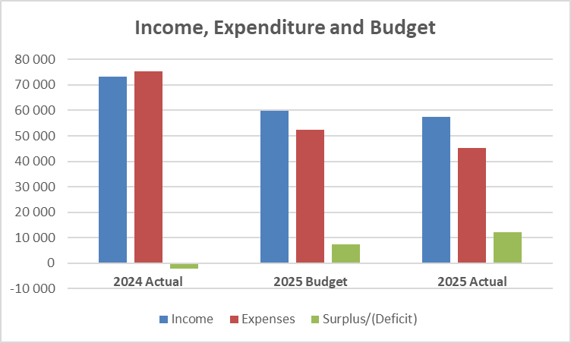
Comparison between last year, budget and this year complicated by change from having a Chaplain, and not. Explanations will be given on the following slides.

Slide 11
INCOME
2025 AND 2024
 | 2025 | 2024
Total Income | € 57,410 | € 73,217

Slide 12
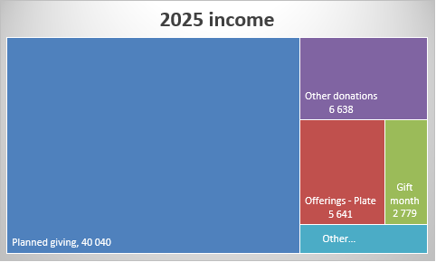
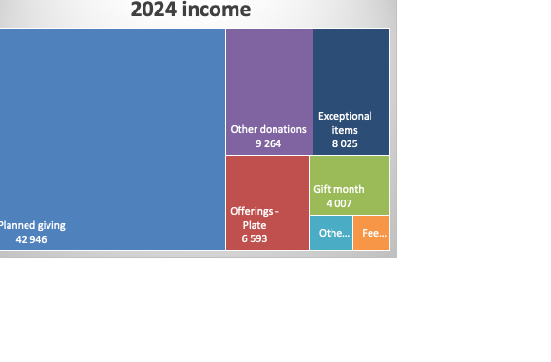
No exceptional income in 2025
No fees (weddings, funerals) in 2025
Decrease of all other income categories from 2024 to 2025, but only as forecast
Planned giving remains the key income source

Slide 13
EXPENDITURE
2025 AND 2024
 | 2025 | 2024
Total Expenditure | € 45,154 | € 75,385

Slide 14
Major changes in expenditure year on year
No Chaplain, so no stipend – reduces expenses by almost €40,000. Locum related costs only €5,500
Cost of Chaplain’s accommodation still affected by major repair costs. €14,000 in 2025. Still more to come with €8,600 repairs expected in 2026
Lower general worship costs as no Chaplain’s travel expenses in 2025
Only 50% of Diocesan Common Fund paid in 2024. Full amount was paid in 2025, plus a « catch up » to pay remainder of 2024 DCF

Slide 15
Excess Income over Expenditure
Summary | 2025
Income | € 57,410
Expenditure | - 45,154
Surplus | € 12,256

Slide 16
Balance sheet at 31st December: Assets
Assets | 2025 | 2024
Bank account | 8,673 | 5,483
Savings account | 40,942 | 27,702
UK Diocese account | 328 | 231
Prepayments | 869 | 1,261
Fixed assets - house | 153,760 | 158,047
Fixed assets - other | 1,471 | 1,419
TOTAL | € 206,043 | € 194,143

Slide 17
Balance sheet at 31st December: Liabilities
Liabilities | 2025 | 2024
Creditors and accruals | 6,762 | 1,024
Ring-fenced donations not used | 7,543 | 9,688
Reserve for invest-ment in house | 153,450 | 157,400
Total liabilities | 167,755 | 168,112
Church funds | 38,288 | 26,031
TOTAL | € 206,043 | € 194,143

Slide 18
Balance sheet at 31st December 2025:
What does it mean?
What we own
Building (cannot be spent) | €153,760
Cash in bank accounts | €49,900
What is already spoken for
Building (cannot be spent) | €153,450
Ring-fenced donations (to be used only as intended) | €7,543
Bills and creditors | €6,762
Available
Church funds | €38,288
In accounting, liabilities shows whose money funded our assets. Church funds are our own accumulated surplus — a reassuring figure on the balance sheet.

Slide 19
In summary
We are not a wealthy organisation: the amount of available funds is modest
Most of our cash is already spoken for: the bulk of our bank balance is reserved for the building or ring-fenced by donor conditions, it is not discretionary
We are stable and currently improving: church funds grew by €12, 257 in 2025. This means we spent less than we received, but this is mostly because we did not pay a chaplain’s stipend.

Slide 20
CHRIST CHURCH LILLE Budget for 2026

Slide 21
2026 Budget
Summary of Income and Expenditure
 | 2026
Income | € 50,277
Expenditure | € 40,314
Surplus | € 9,963
The budget has been prepared on the assumption that there is no Chaplain, and so no stipend cost
Alternative estimates of expenditure if there is a Chaplain have also been prepared so that when our recruiting efforts are successful, we can update the budget for the months after the arrival of the Chaplain.

Slide 22
Comparison of 2026 Budget - Income
Income for 2026 is forecast to fall by about €7,000:
Three items were received in 2025 but are not budgeted nor expected for 2026:
anonymous donation of €5,000, ring-fenced for house repairs.
donation of €1,000 in the UK
gifts in kind (set against corresponding expenses)

Slide 23
Comparison of 2026 Budget - Expense
Major repair costs at the Chaplain’s accommodation should be €5,000 lower than in 2025
The increase in Church building costs relates to electricity and gas, based on the level of bills received so far this winter
2025 Diocesan costs included a « catch up » for 2024 which will not happen again this year

Slide 24
And if we have a Chaplain?
We are keeping our options open and there are three ways in which we may attract our new Chaplain:
House for Duty : we provide accommodation but no Stipend. The Chaplain works 2 days a week
Half-Stipend : we pay 50% of the usual Stipend and the Chaplain works 4 days a week
Full-Stipend : we pay a full Stipend and the Chaplain is full time.
(1 day = 3 sessions, morning/afternoon/evening)

Slide 25
Reports
Chaplain’s report
Finance report
Fabric report

Slide 26
Fabric Report
The church building belongs to the town hall, whose staff have been very cooperative.
Awaiting timelines for roof, lighting, toilets and disabled access works.
Heating management remains a challenge, depending on volunteers to manually switch the system on and off.
Chaplaincy house received new doors/windows, a burglar alarm, and minor refurbishments.

Slide 27
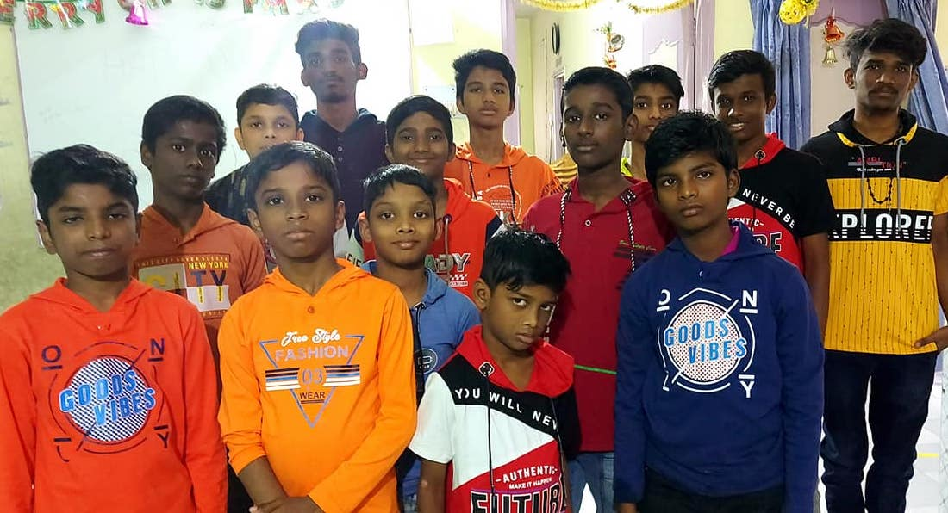
Outreach
In spite of difficulties, we managed to support various organisations during 2025, including the Beth Abi orphanage in India.
A full report on the grants we made and the organisations we support can be found on our website.

Slide 28

Ladies’ Bible Study
A special place for connection, encouragement, and spiritual growth. Gathering weekly during term time, a friendly group of six to eight women meets in the church hall to explore God’s Word together.

Slide 29

Morning Music
Members rehearse on Friday evenings and play for most Sunday morning services.
In 2025, extra rehearsals meant we were able to provide the music for Nine Lessons and Carols, as well as for Holy Week services.
However, most of the microphones, cables, and music/microphone stands are very worn and in danger of needing replacing.
Electric piano, guitar, singers … the organ remains key to successful special services.

Slide 30

Working with Christ
Saturday morning prayer group for professional people.
Working with Christ is an opportunity for professionals and students to meet, discuss issues linked to work or studies, including in very practical terms, and bring them before God in prayer.

Slide 31
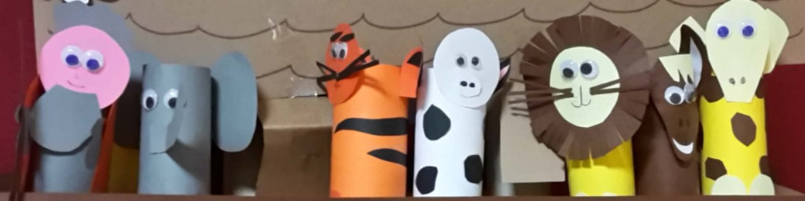
Sunday Club
Sunday Club cannot operate on a regular basis until the required safeguarding clearances are in place. Our current focus is therefore on ensuring that at least two people obtain the necessary clearances and complete the required Basic and Foundational safeguarding training.
Once this is done, we look forward to re-establishing Sunday Club as a regular and valued part of our Sunday morning worship.

Slide 32

Eco Church
We need to care for creation
We continue to work on
reducing our carbon footprint
reducing energy consumption
encouraging everyone to become more aware
And it’s automatically part of our church council agenda

Slide 33
Communications
Zoom
Our Zoom account continues to be used for meetings of all kinds.
Website and newsletter
These reach our community, friends around the world, visitors and the curious. There are currently 146 subscribers to the Newsletter. We would love some help here.
Social Media
We use FaceBook but would love a volunteer to keep it up to date more regularly.
Video and audio
Our YouTube channel is still popular and there are occasional new videos to watch. We create an annual video Christmas card and also an Easter card
We need now to think about updating the website and the newsletter: a monthly newsletter with longer articles is one idea, while the weekly information would become a simpler pew sheet.
Send us your suggestions!

Slide 34
CCL AGM 2025 AGENDA
Opening with prayers
Apologies for absence
The electoral roll
Minutes of the AGM held on 3 May 2022
Matters arising
Reports
Chaplain’s report
Finance Report
Fabric report
Other reports
Safeguarding
Elections and appointments
Churchwardens
PCC Members
Independent account examiner
Future plans
Any other business
Closing prayers

Slide 35

Safeguarding
Our commitment to providing a safe environment is integral to what we do
Thank you to everyone who takes part in training and to leaders and volunteers, who are vital to ensuring the safety and well-being of everyone in our care

Slide 36
CCL AGM 2025 AGENDA
Opening with prayers
Apologies for absence
The electoral roll
Minutes of the AGM held on
Matters arising
Reports
Chaplain’s report
Finance Report
Fabric report
Other reports
Safeguarding
Elections and appointments
Churchwardens
PCC Members
Independent account examiner
Future plans
Any other business
Closing prayers

Slide 37
Elections and Appointments

Slide 38
Church Council Members
Ex-officio:
Chaplain
2 Churchwardens
2 Lay Archdeaconry Synod Representatives (and any General or Diocesan Synod representatives)
Lay Reader
Evening Service Representative
Elected:
8 elected members in total

Slide 39
CANDIDATES FOR CHURCHWARDEN (Elected annually)
David Bolton
Maggie Devos

Slide 40
CANDIDATES FOR LAY ARCHDEACONRY SYNOD REPRESENTATIVES (Elected every three years)
Rosemary Ulyett
Maggie Devos

Slide 41
CHURCH COUNCIL MEMBERS
Candidates:
Harriet Godfrey
David Newlands
D Ross
F Coester
V Swain
Candidates for Churchwarden or Lay Synod representative are also eligible for the PCC if not elected to that specific role.

Slide 42
Independent Accounts Examiner
We thank Louise for her work last year, and she has indicated she is willing to continue in this role
Louise Cossey

Slide 43
Full reports will be available on the website.
A summary of the financial situation will also be made available.

Slide 44
ANY OTHER BUSINESS AND CLOSING REMARKS

